Slide 1
Houston Housing
The Impact of Various Factors on Housing Costs

Slide 2
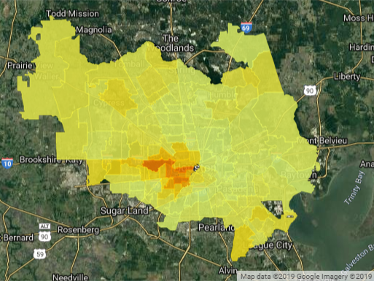
Property Value
Data Sources
FEMA
Zillow
Attom Data Solutions
Government Sources
Google Maps/APIs
Trends
Values rise in Downtown Houston
Smaller increases on the outskirts

Slide 3
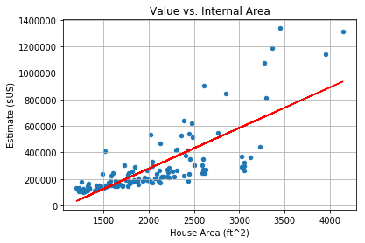
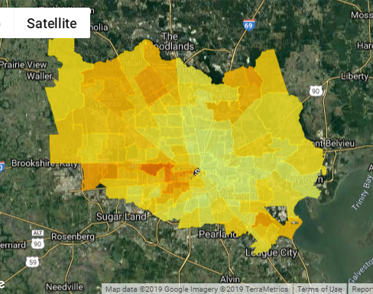
House Footage Trends
Fewer zip codes
R value is .772
Strong positive relationship

Slide 4
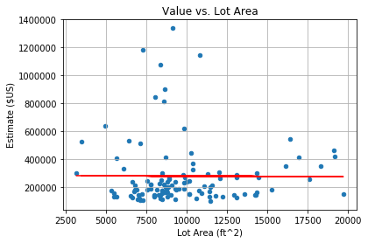
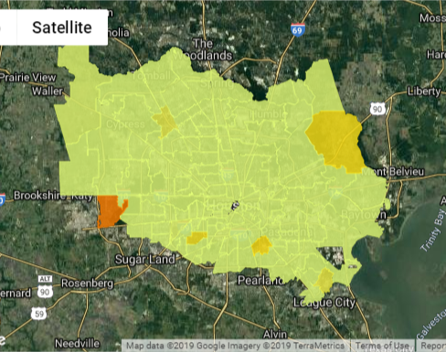
Lot Footage Trends
Fewer zip codes
R Value is -.006
No effective relationship

Slide 5
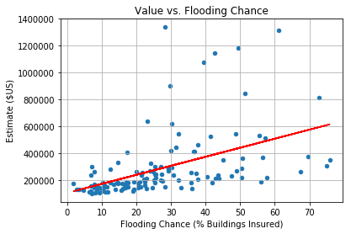
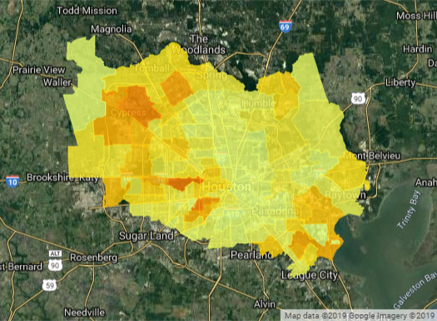
Flood trends
Data available for fewer zip codes
R-value is 0.467
Weak positive relationship
Both are likely dependent on another variable.

Slide 6
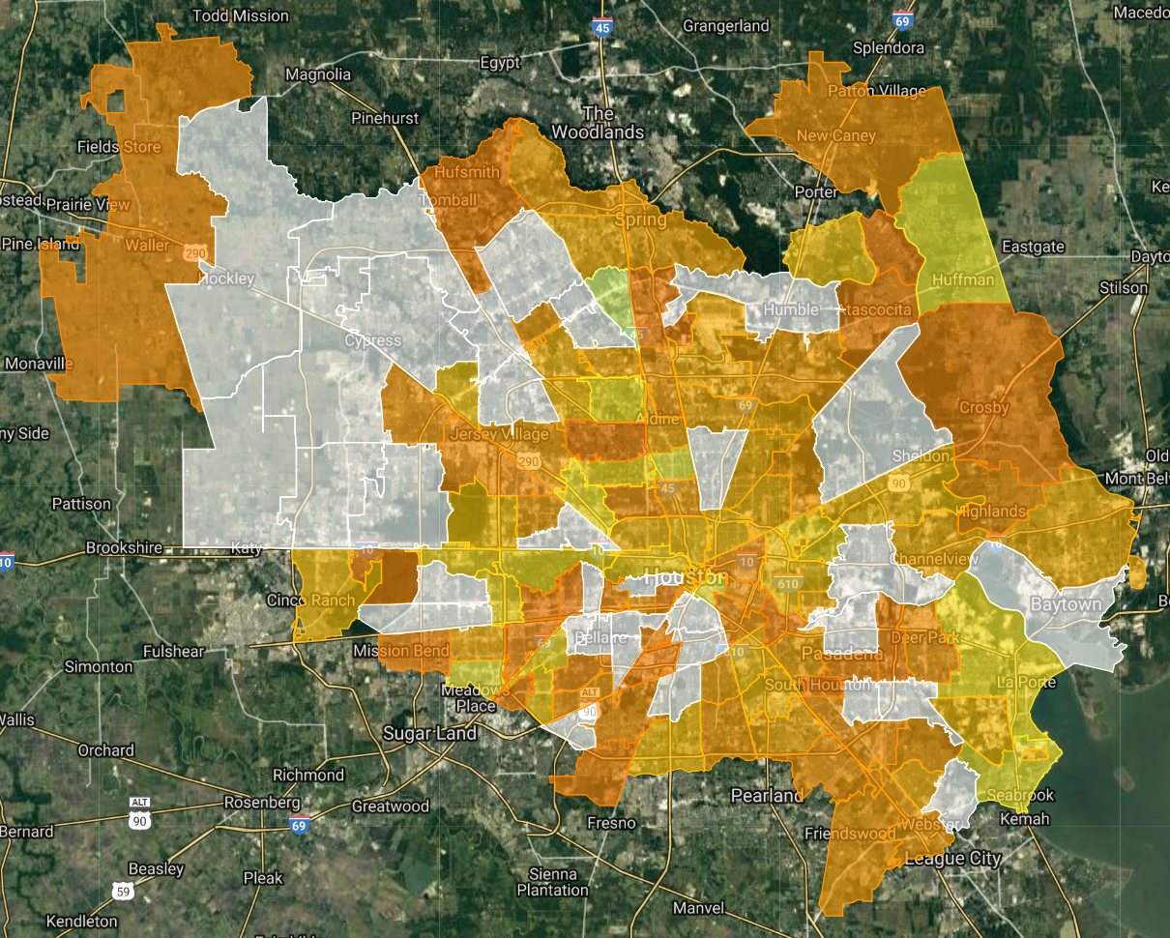
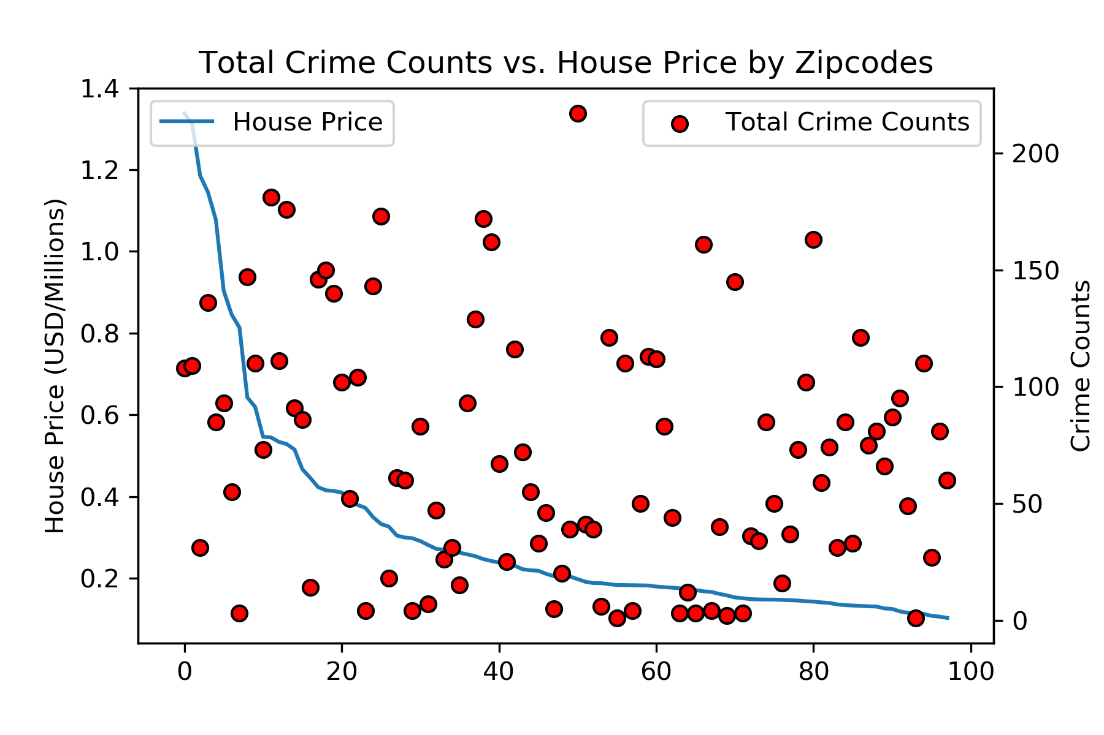
Crime Distribution by Zipcode
No obvious correlation (R² = 0.20)

Slide 7
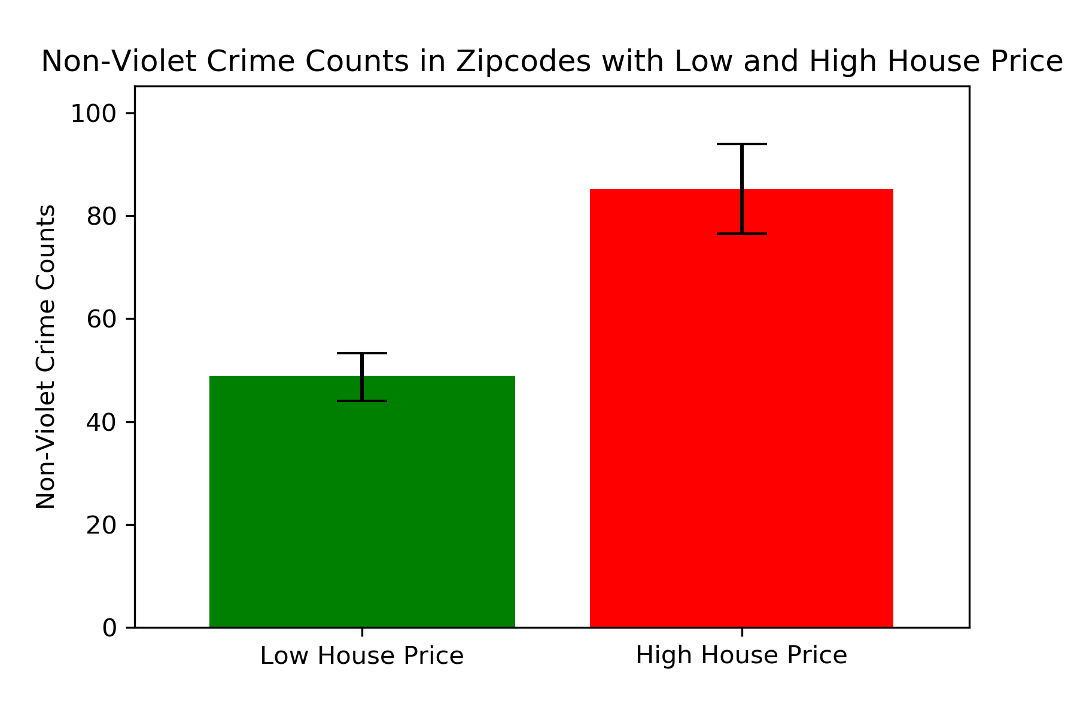
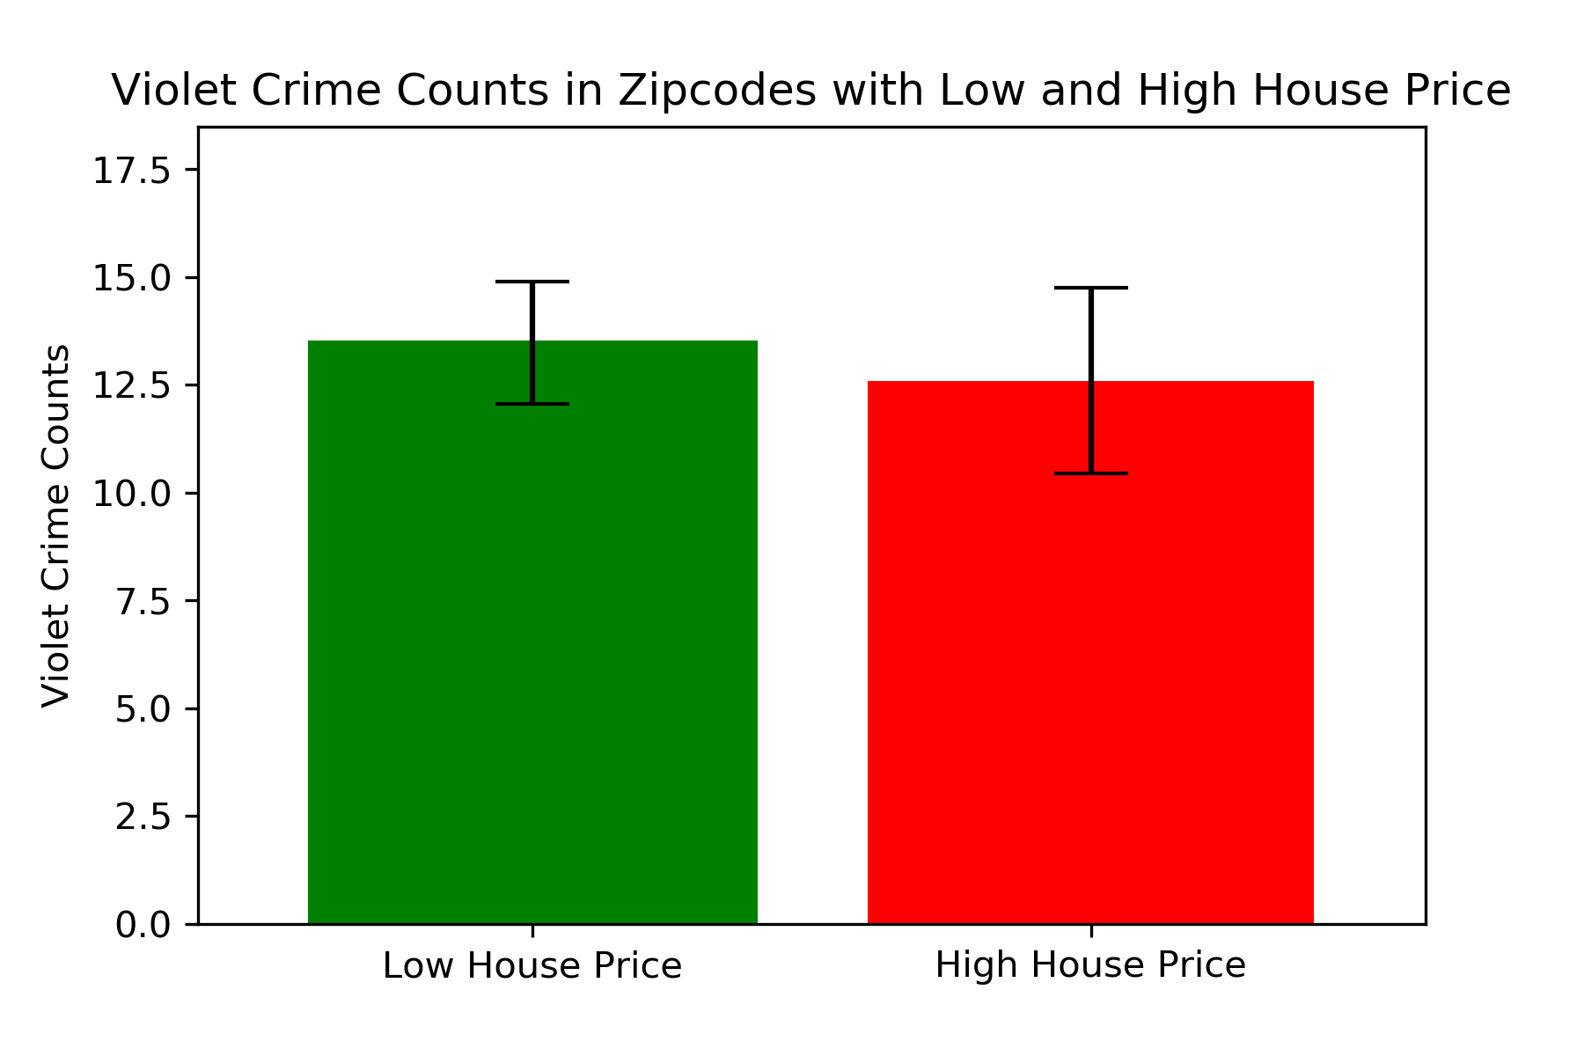
Crime Categories Impacted by House Price

Slide 8
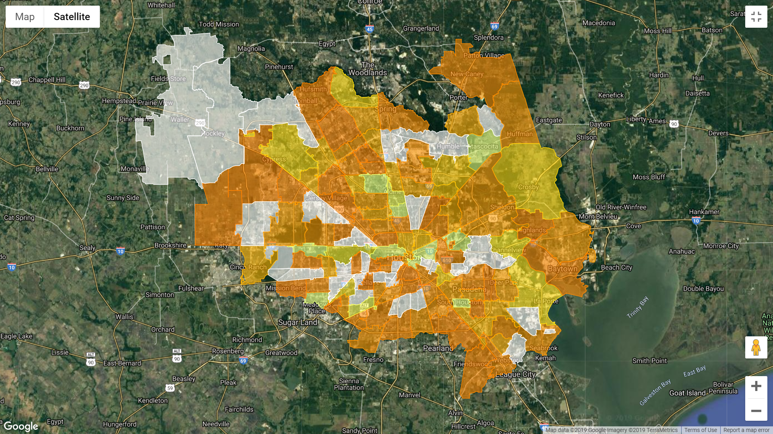
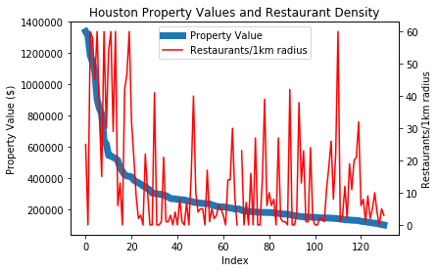
Restaurant Density
Correlation Coefficient: 0.47
weak positive linear relationship between property value and restaurant density
Highest restaurant density in central Houston and in some periphery

Slide 9
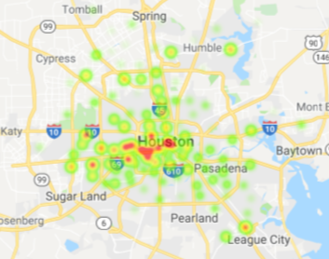
Restaurant Density
Correlation Coefficient: 0.47
weak positive linear relationship between property value and restaurant density
Highest restaurant density in central Houston and in some periphery

Slide 10
Final Insights
House square footage matters to the price you’ll pay, but the Lot has little effect.
Flooding has some effect on the price, but requires more research.
The more you pay, the more likely you are to have non-violent crime happen in your area. Violent crime rates stay about the same.
The more restaurants in an area, the more the average cost.
And Lastly,
Downtown Houston is expensive

